Slide 1
Energy Research Unit
Introduction:
Due to the growing demand for energy and the increasing shortage of traditional energy sources and the accompanying problems, the trend to use renewable and alternative energies, with the necessity of energy conservation, is an imperative, locally and internationally.
The Energy Research Unit was established on February 18, 2014, at the College of Engineering in Abi Qir, to provide solutions appropriate to the nature of the applicant, whether at the academy's level in all its branches or through its role in community service.
مقدمة:
- نظرًا للطلب المتزايد على الطاقة والنقص المتزايد في مصادر الطاقة التقليدية وما يصاحب ذلك من مشاكل ، فإن الاتجاه إلى استخدام الطاقات المتجددة والبديلة ، مع ضرورة الحفاظ على الطاقة ، أمر حتمي محليًا ودوليًا.
- تم إنشاء وحدة أبحاث الطاقة في 18 فبراير 2014 ، بكلية الهندسة بأبي قير ، لتقديم الحلول المناسبة لطبيعة المتقدم. سواء على مستوى الأكاديمية بكافة فروعها أو من خلال دورها في خدمة المجتمع.

Slide 2
Energy Research Unit
Mission
link the energy research with the community needs in order to find an implementable solution for energy problems, in addition to deliver the technical support in AAST and community.
الرسالة:-
ربط أبحاث الطاقة باحتياجات المجتمع من أجل العثور على حل قابل للتنفيذ لمشاكل الطاقة ، الإضافة إلى تقديم الدعم التقني في AAST والمجتمع.
الأهداف:-
- ربط البحوث المتعلقة بالطاقة بالاحتياجات الحالية والخطة المستقبلية من AAST والمجتمع.
- تكامل ودعم البحث من خلال تشجيع مشروعات متعدد التخصصات لتقديم حل مبتكر.
- جعل الأكاديمية العربية للعلوم والتكنولوجيا مركزا متميزا في مجال الطاقة
Objectives
Link the researches related to energy with the current needs and future plan of the AAST and community
Integrate and support the research through the encouragement of multi-discipline project to deliver an innovative solution
Make AAST as a center of excellence in the field of energy

Slide 3
Energy Research Unit
لجنة الطاقة:-
تم إنشاء لجنة للطاقة من أجل المساعدة في تحقيق الأهداف، والمهمة الرئيسية هي بناء نظام إدارة الطاقة
Energy Committee
An energy committee has been established in order to help in achieving the objectives.
The main task of energy committee is to build an Energy management system.

Slide 4
Energy Research Unit
Activities:
The establishment of an energy committee at the academy level
Conducting the necessary studies for energy conservation in a number of buildings in the Academy Via :
1- Providing advice, conducting the necessary studies, and using LED technology.
2- Conducting the necessary studies for the use of solar PV cells in a number of the academy's headquarters.
3- Evaluating a study presented on the use of solar heaters in hotel buildings at the Abu-Qir site and providing advice .
4- Do necessary studies to monitor Loads.
الانشطة:-
- انشاء لجنة الطاقة علي مستوي الاكاديمية.
- اجراء عدد من الدراسات لترشيد الطاقة لعدد من المباني بالاكاديمية مثل:
1-تقديم المشورة باستخدام حلول led واجراء الدراسات اللازمة.
2-اجراء الدراسات اللازمة لاستخدام انظمة الخلايا الشمسية PV
3-تقييم دراسة مقدمة عن استخدام السخانات الشمسية في مباني الفنادق بالاكاديمية موقع أبو قير وتقديم النصائح والتوصيات.
4-عمل الدراسات الازمة لمراقبة في الاحمال.

Slide 5
Energy Research Unit
Activities:
Work on the Tempus project funded by the European Union between the Academy and some Egyptian and European colleges, and among the project’s :
1- Establishing a house of expertise in the field of new and renewable energy to be the headquarters of the energy unit in the college.
2- Establishing a master's program in energy.
الانشطة:-
العمل في مشروع Tempus الممول من قبل الاتحاد الأوروبي بين الأكاديمية وبعض الكليات المصرية والأوروبية ومن ضمن مشروعاتها
1- إنشاء بيت خبرة في مجال الطاقة الجديدة والمتجددة لتكون مقر وحدة الطاقة بالكلية.
2- إنشاء برنامج ماجستير في الطاقة.

Slide 6
Energy Research Unit
- ( lab 501 )

Slide 7
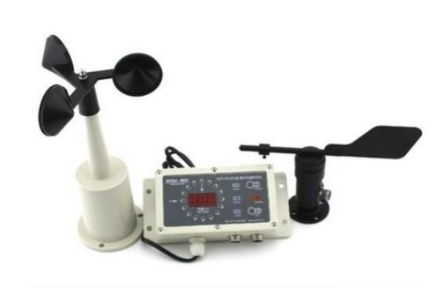
WTF-B200 Wind Speed and Direction Anemometer
- Whole set of WTF-B200 wind vane anemometer includes WTF-B200 display, WFS-1 wind speed
sensor, SC/FX wind direction sensor and cables.
Application
- Cranes
- Weather
- Agriculture
- Hydraulic and Hydroelectricity
- Construction
- Education

Slide 8
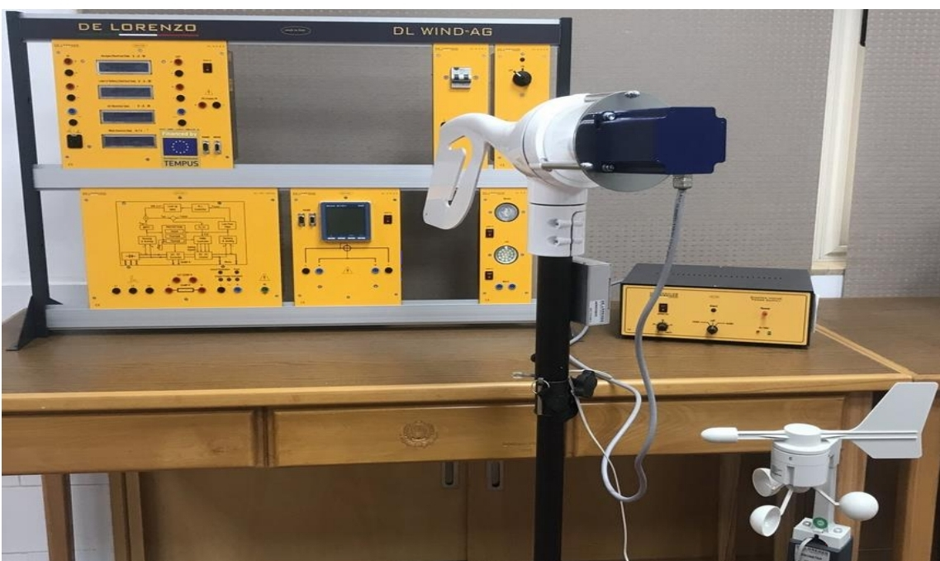
WIND ENERGY MODULAR TRAINER WITH CONNECTION TO MAINS
Didactic system for the study of the generation of electric energy from a wind turbine and its inlet in the mains network.
The device includes a stepper motor kit to drive the wind generator in absence of wind.
Complete with connecting cables, experiment manual and software for data acquisition and processing.

Slide 9
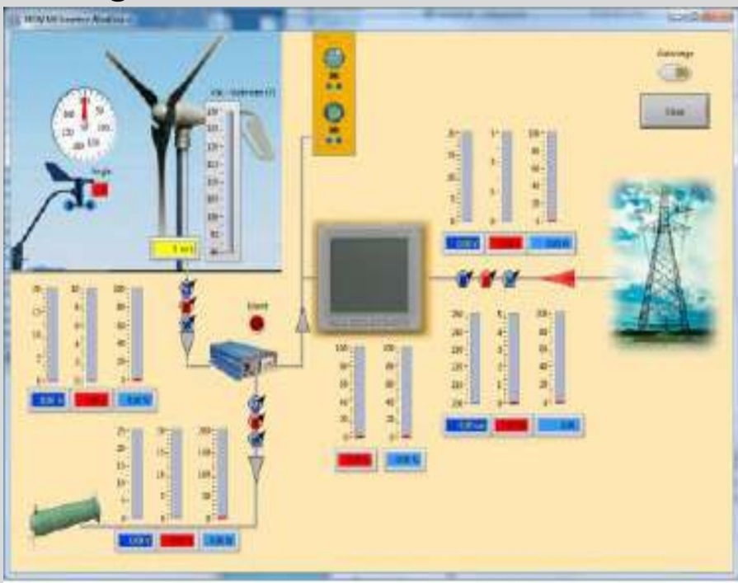
WIND ENERGY MODULAR TRAINER WITH CONNECTION TO MAINS
TECHNICAL SPECIFICATIONS
- A wind turbine, 400W, 12Vac.
- Anemometer and wind direction sensor mounted on a stand.
- A supporting frame for the modules.
- A braking resistance, 250 W, 3 Ohm.
- A load module. It includes two mains voltage
lamps, dichroic 35W and LED 3W, with independent switches.
- A module for the measurement of: wind speed (m/s), wind direction (degrees), current up to 30V, ± 15A (two dc ammeters), voltage up to 30V and power up to 1000W.
- Grid tie inverter.
- An energy measurement module.
- A differential magneto-thermal switch.
- A network distributor.
- A motor kit for driving the wind turbine, composed of a stepper motor and a 300 W power supply.

Slide 10
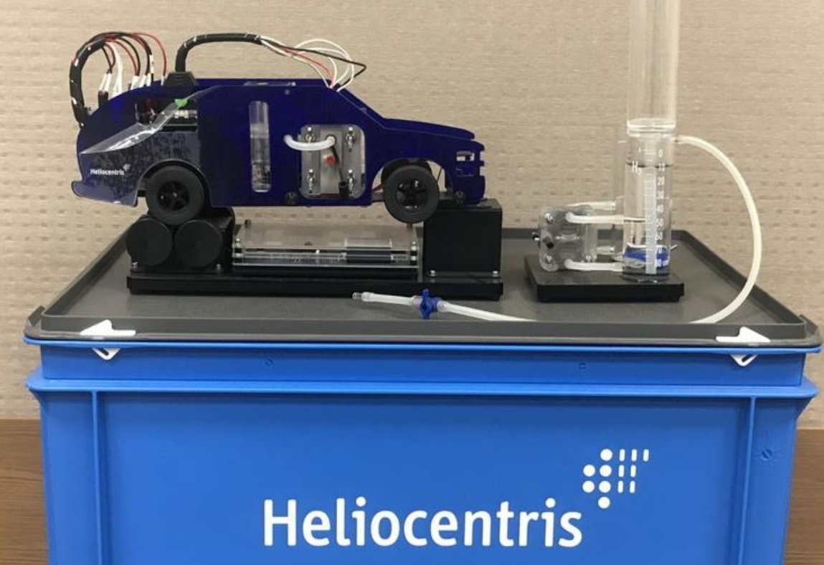
HyDrive Electric Hybrid Vehicle Trainer. (HELIOCENTRIS)
The modular set-up allow users to examine separate subcomponents or the complete hybrid system
Components
- Fuel Cell Stack
- H2 Gas Storages (2 pieces)
- Fan
- Supercapacitor
- Hydrogen Filling Station - Test Bench Controlle
- Energy Management Board

Slide 11
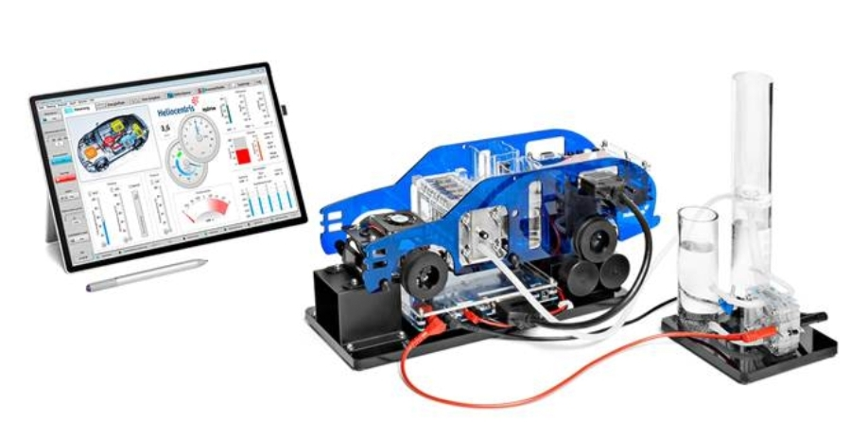
HyDrive Electric Hybrid Vehicle Trainer. (HELIOCENTRIS)
Exepriments:-
- The charge and discharge characteristics of a supercapacitor
- The characteristic curve of a fuel cell and its maximum power point
- The relationship between the fuel cell performance and air supply
- The basic equation of motion and the conversion of electrical to mechanical power
- The characteristic curve and energy efficiency of an electrolzer
- FCEVs in practice: the recuperation of breaking energy
- Constructing and testing a hybrid system

Slide 12
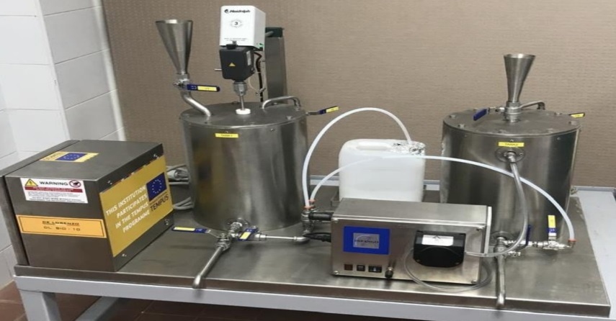
PLANT FOR THE PRODUCTION OF BIODIESEL
Description of the process
Oil and glycerin are inserted In the pretreatment tank and heated to 50 °C, continuously stirring. The mixture is then settled and decanted to remove any impurities from the oil, The oil is then heated to 70-90 °C until the bubbles disappear.
Then, by means of the pump, the oil is sent to the reactor and heated, while keeping the temperature between 50 and 55 °C.
Methanol and sodium are mixed in the methoxide tank.
The recirculation of the oil starts with the pump and is continued, while 75% of prepared methoxide is added in 1.5 hours. Let stand and decant.
The recirculation of the oil starts again, while 20% of the methoxide is added in 1.5 hours. Let stand and decant.
The recirculation of the oil starts again, while the remaining 5% of the methoxide is added in 1.5 hours. Let stand and decant. In this way biodiesel is obtained. The next step is to wash and purify it.

Slide 13
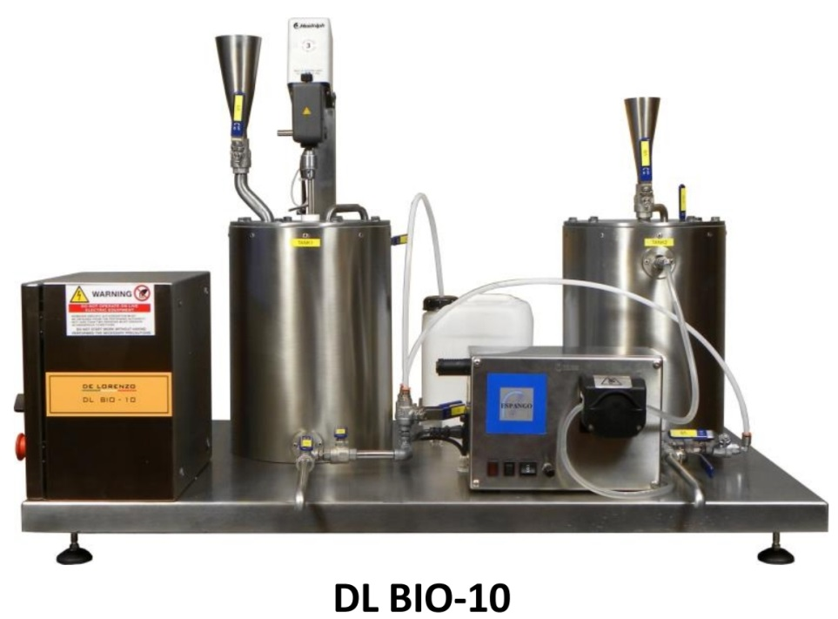
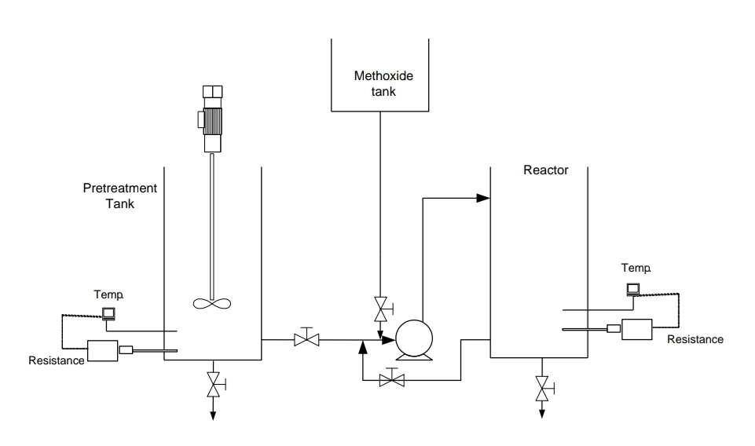
PLANT FOR THE PRODUCTION OF BIODIESEL
List of Experiments
Biodiesel synthesis and determination of the density of the product
Experiment 1 - Biodiesel synthesis from unused and used sunflower oil. Using methanol and sodium hydroxide.
Experiment 2 - Biodiesel synthesis from unused and used sunflower oil. Using methanol and potassium hydroxide.

Slide 14
Computer Controlled Thermal Solar Energy Unit, with SCADA
EXERCISES AND PRACTICAL POSSIBILITIES TO BE DONE:
1.- Study of the thermosiphon operation.
2.- Study of the luminosity profile of the lamps.
3.- Study of the efficiency of the solar panel.
4.- Study of the influence of the tilt angle of the lamps panel on the unit efficiency.
5.- Study of relation between the flow and the temperature.
6.- Study of energy balance of the solar collector.
7.- Study of energy balance of the accumulator tank.
8.- Determination of the experimental efficiency.
9.- Study of the influence of the angle of incidence on the temperature.
Additional practical possibilities:
10.-Sensors calibration.
11.-Flowmeter calibration.

Slide 15
Computer Controlled Thermal Solar Energy Unit, with SCADA
Other possibilities to be done with this Unit:
12.-Many students view results simultaneously.
To view all results in real time in the classroom by means of a projector or an electronic whiteboard.
13.-Open Control, Multicontrol and Real Time Control. This unit allows intrinsically and/or extrinsically to change the span, gains; proportional, integral, derivative parameters; etc, in
real time.
14.-The Computer Control System with SCADA allows a real industrial simulation.
15.-This unit is totally safe as uses mechanical, electrical/electronic, and software safety devices.
16.-This unit can be used for doing applied research.
17.-This unit can be used for giving training courses to Industries even to other Technical Education Institutions.
18.-Control of the EESTC unit process through the control interface box without the computer.

Slide 16
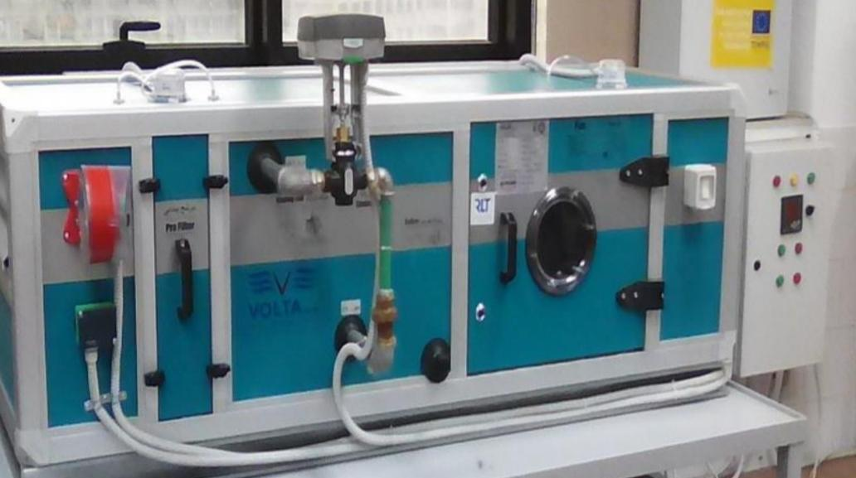
Air-handling units
Complete solution with full features for your energy efficient AHU, connected to a Building Management System.

Slide 17
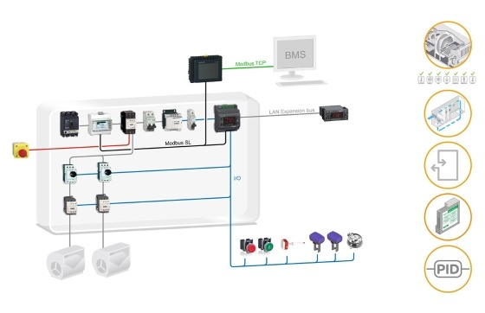
Air-handling units solutions
Solution for simple or compact air handling units, heat recovery units and ventilation units.
Solution
Solution based on the Modicon M171 optimized logic controller, which allows you to build your equipment for simple and compact machines.
Benefits
> Solution can be tailored to your needs with the Modicon M171 optimized logic controller: in 24V AC/DC and 110-230VAC.
> Compact controller reduces cabinet size in DIN package or flush mounting.

Slide 18
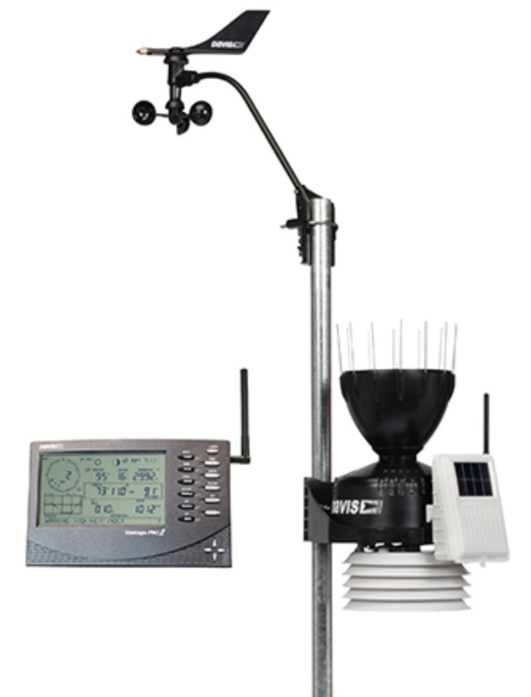
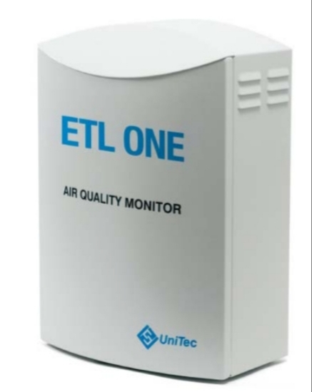
* Precision weather station VANTAGE PRO 2. (DAVIS) * ETL3000/ETLONE Multi-Component Air Quality Monitor.
Wireless Vantage Pro2™ with Standard Radiation Shield
A weather station with customizable features and robust performance: perfect for the serious weather watcher.

Slide 19
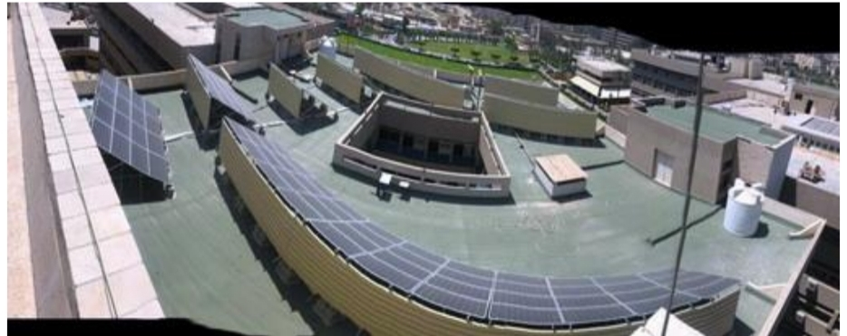
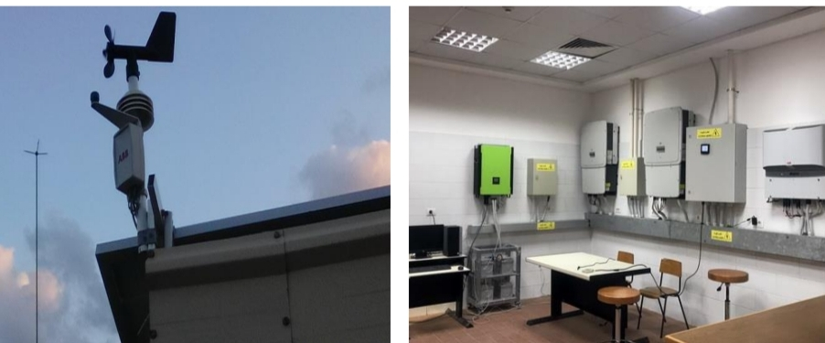
48.4 kW Solar Power Plant (On-Grid) with Weather Station. (ABB)
- The station make student learn and study how do solar panels work for your home and other prepossess.
- Solar panels work by absorbing sunlight with photovoltaic cells, generating direct current (DC) energy, and then converting it to usable alternating current (AC) energy with the help of inverter technology.

Slide 20
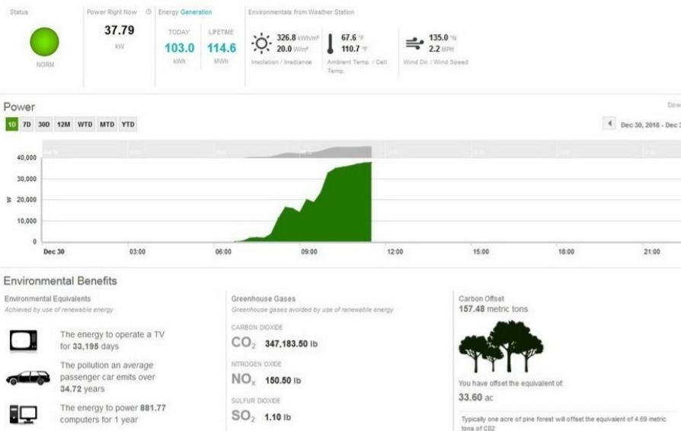
48.4 kW Solar Power Plant (On-Grid) with Weather Station. (ABB)
plant viewer
The productivity of the station can be monitoring with PC Monitoring Software (Aurora Vision) which can
give us the states of the station the power right now in KW, energy generation in KWh and
environmental from weather station like insolation/ irradiance, ambient temp/ cell temp and wind
Direction/ wind speed all of this called the plant viewer.

Slide 21
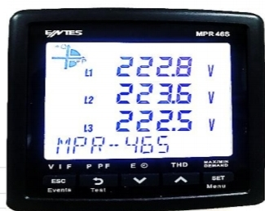
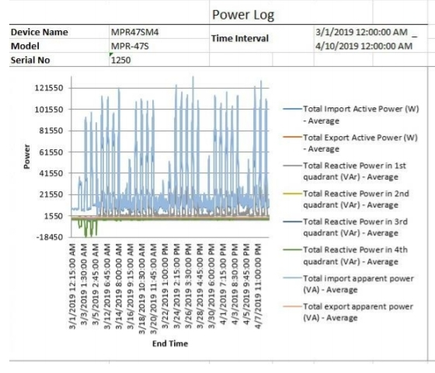
48.4 kW Solar Power Plant (On-Grid) with Weather Station. (ABB)
Also there is ENTES MPR46S Network Analyzer a microprocessor-based device which are designed to measure all parameters of an electrical network,
Measured parameters can be recorded in real-time with flash memory and Real Time
Clock Chip.
The recorded values then can be accessed and monitored remotely via RS-485 line with Modbus RTU protocol.

Slide 22
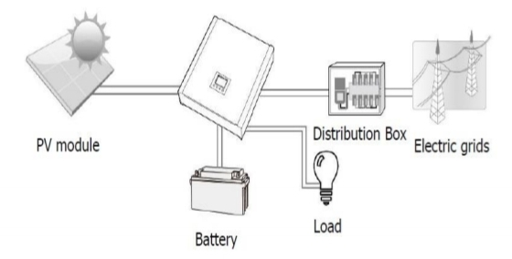
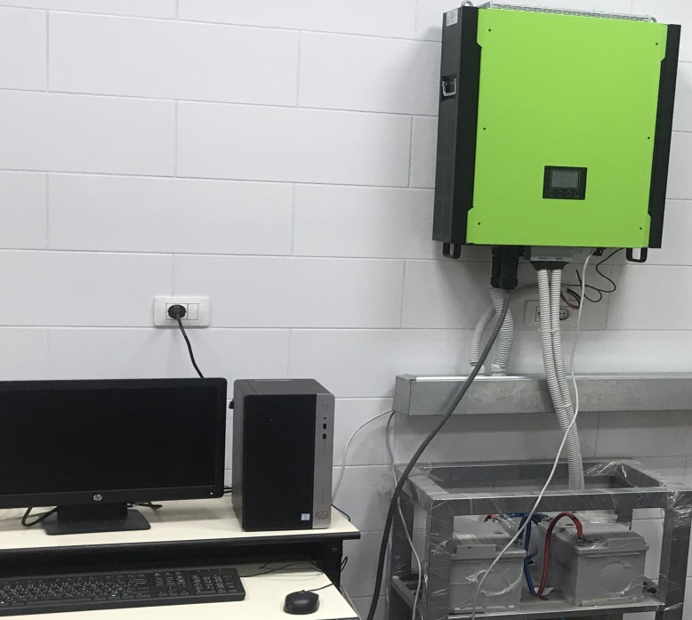
Hybrid 10 kW PV Inverter. (InfiniSolar)
This hybrid PV inverter can provide power to connected by utilizing PV Power, utility and battery power.
Depending on different power situation, this hybrid inverter is designed to generate continuous power from PV solar modules (solar panels), battery, and the utility.
There are three operation modes: Grid-Tie with backup, Grid-Tie and Off-Grid.

Slide 23
Training courses
Renewable Energy System
Solar energy
Practical fundamental solar energy
Wind Energy System
Energy Management and Auditing (EMA)
Building Management system (BMS)

Slide 24
1-Renewable Energy System
Learning Outcomes: | -Understand the principle of renewable energy. -Select the suitable renewable energy resources . -know different resources of renewable energy.
Course contents: | - Energy resources and overview of world energy. - Energy demand and production / Consumption . - Energy conversion and storage. - solar energy - wind energy - Hydro-power - Bio-energy . - Practical / Laboratory. - Advanced topics of renewable energy. - Application and case study.

Slide 25
2-solar Energy
Learning Outcomes : | -Understand the concept of solar energy. -Know the application of solar thermal system. -Design solar thermal system.
Course contents : | - Fundamental of solar astronomy. - Solar radiation. - Introduction to concentrator optics. - PV system. - High temperature systems. - Solar collectors theory and technology energy in Solar collectors. - Flat plate collectors design. - Solar water heating and Solar heating. - Solar air heating. - Solar air cooling and liquid absorption technology.

Slide 26
3- Practical fundamental solar energy
Learning Outcomes : | - Understand the principle of solar energy. - Differentiate between on-grid and off-grid PV system. - Know the components and operation of solar heater.
Course contents : | - PV system components and configurations. - PV types and solar inverters - On-grid PV system. - Off-grid and hybrid PV system. - PV installation - Solar heater. - practical / laboratory.

Slide 27
4-Wind Energy System
Learning Outcomes | - Understand the feature, characteristics and types of wind turbine - Select the suitable wind turbine. - Design and control wind farm.
Course contents | - Introduction to wind energy. - Wind turbine characteristics and resources. - Aerodynamics of wind turbines. - Wind turbine mechanics and dynamics. - Wind turbine generations. - Wind turbine installation. - Tends in control system design of wind turbine. - wind turbine design calculations - Environmental aspects - Wind turbine economics.

Slide 28
5. Energy Management and Auditing (EMA)
Learning Outcomes : | - Understand the codes and standards of energy . - Understand the concept of energy audits and procedures. - Know the tools and equipment needed to perform an energy audit . - Learn how to write energy reports.
Course contents : | - Fundamentals of Energy management system. . - Energy efficient and conservation. - Introduction, codes standards & Legislation I & Legislation II - Types of Energy audits and its basics component . - The audit Process i- Pre site work ii- Preparing for audit visit ii- post Audit Analysis iii- The Energy audit Report. - The Energy action Plan Specialized audit tools. - The Building Envelope Audit. - The Electric system Audit. - The Indoor Air Quality and HVAC Audit. - Industrial, Commercial and Residential audits . - Energy efficient and renewable energy. - Energy management automation.

Slide 29
6. Building Management system (BMS)
Learning Outcomes : | - Understand the principles of BMS system. - Select the suitable lighting and HVAC systems of energy efficient applications. - Know BMS configurations and technologies. - Design BMS system.
Course contents : | - Overview on energy management and control. - Fundamentals of Energy auditing . - Energy efficient and renewable energy. - Energy conservation techniques and performance assessment for lighting systems. - Lighting control and efficiency standards. - Residential and commercial lighting systems. - Energy conservation techniques and performance assessment for HVAC systems. - Building insulation and air leakage. - Solar Heating and HVAC application. - BMS control system and automation. - Design and installation of BMS.

Slide 30
Thank you for you attention
Contact: info@weset-project.eu
Fernando.Tadeo@uva.es

